Slide 1
ASTLI
Advanced
Smart
Traffic Lights
Andrea Leganza
Ghenadie Artic
Alberto Coluzzi

Slide 2
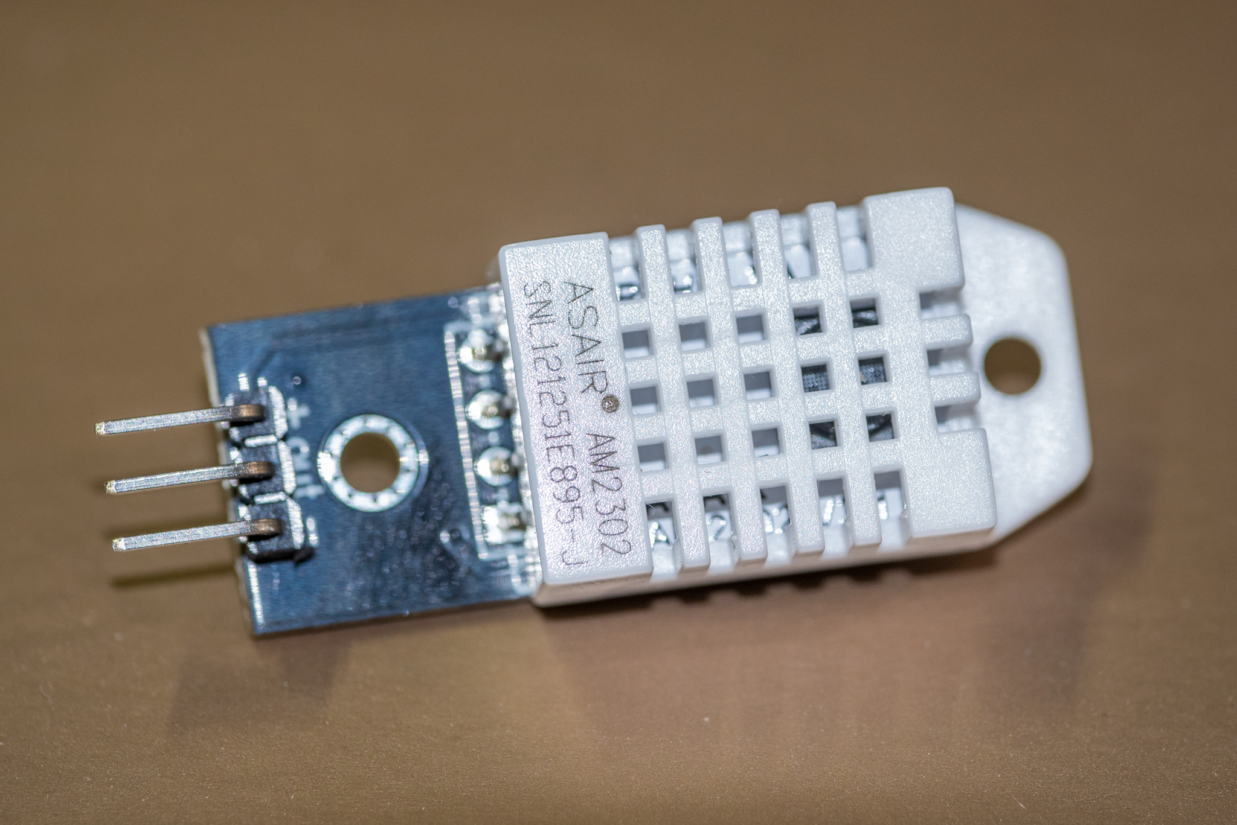
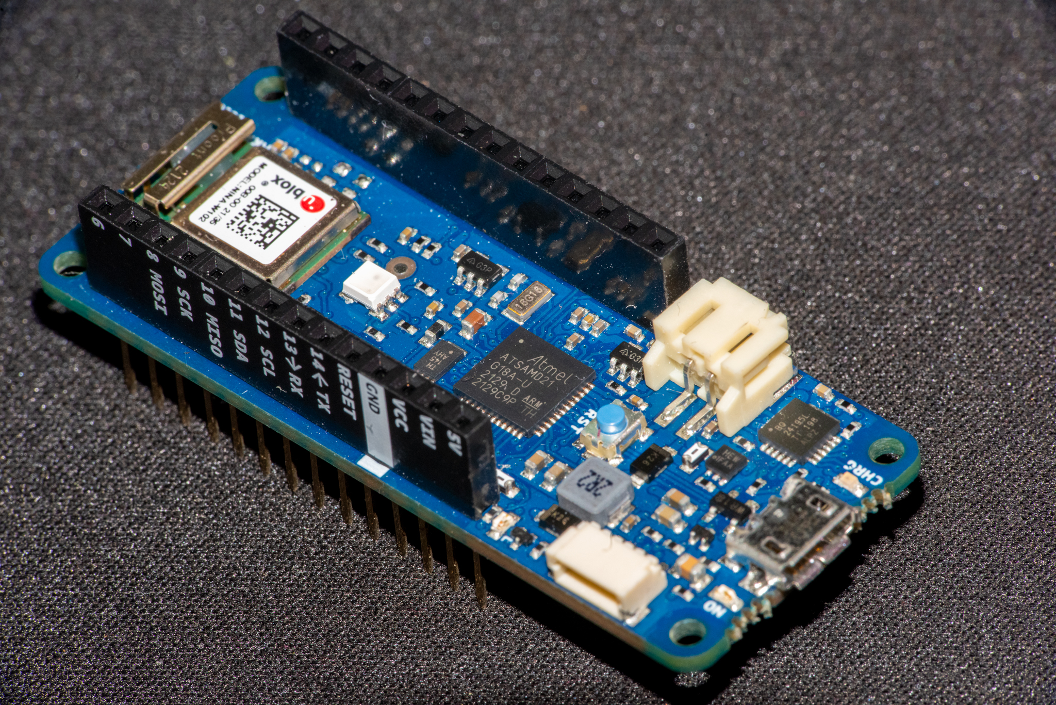
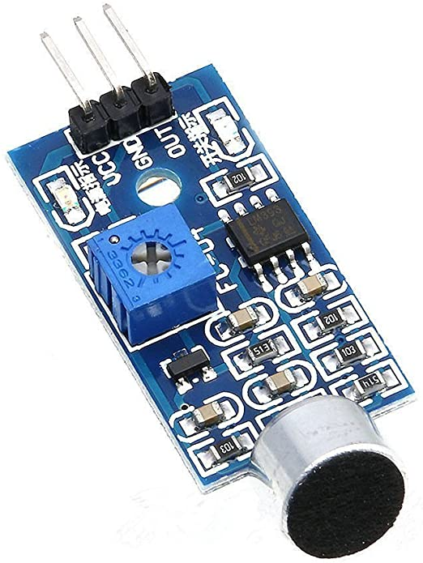
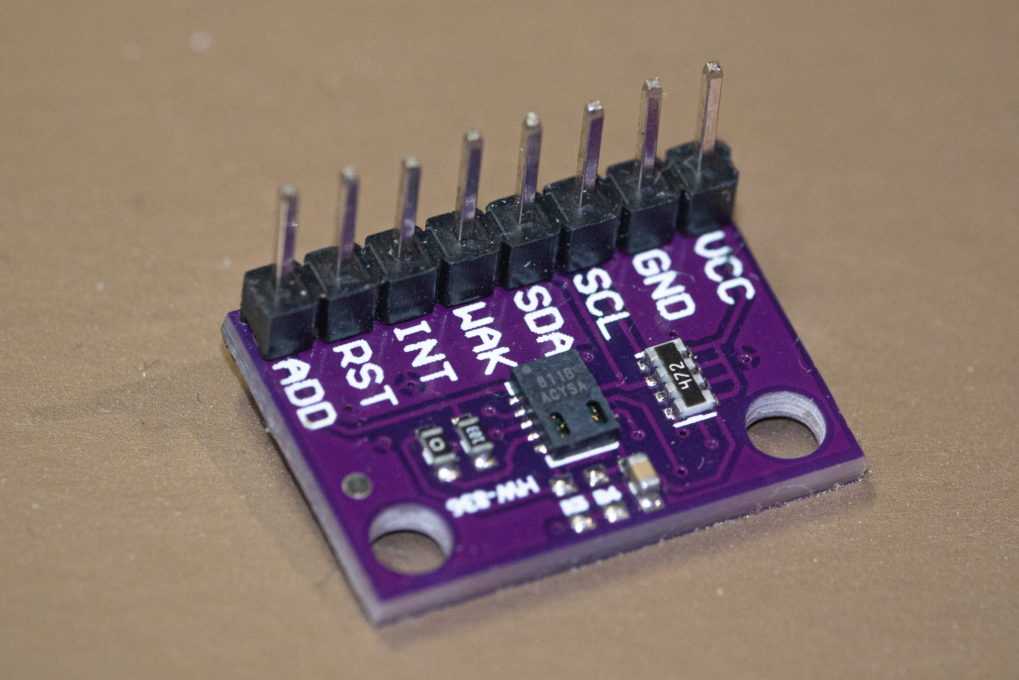
ASTLI
Arduino MKR 1010
Humidity and temperature
Sound
Pollution
Board: Arduino MKR 1010
Sensor: monitoring of pollution
Sensor: monitoring of noise
Sensor: monitoring of temperature & humidity

Slide 3
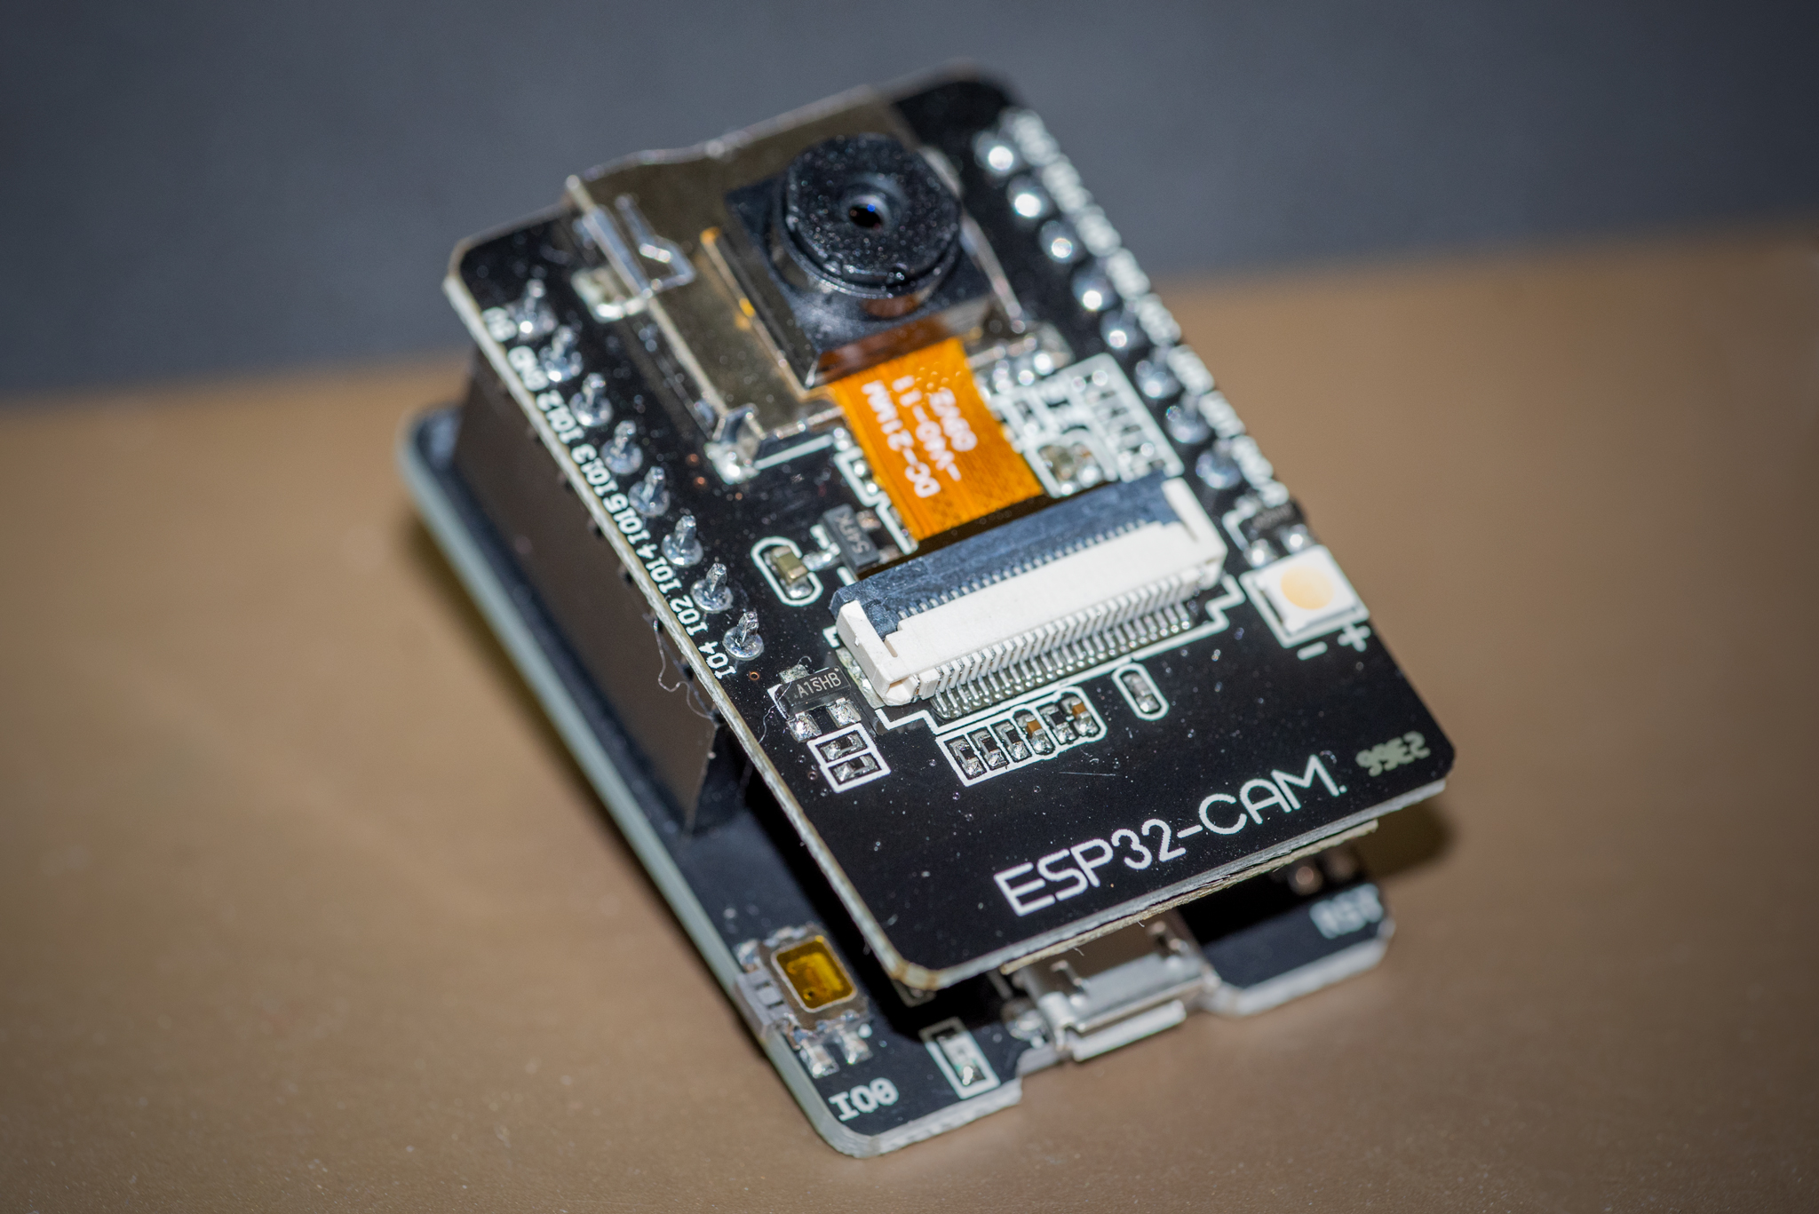
ASTLI
ESP-32
Traffic jams: ESP-32 camera (data capture)

Slide 4


ASTLI
Arduino
Central ESP-32
ESP-32

Slide 5

ASTLI
ESP32
Data analysis: AWS

Slide 6
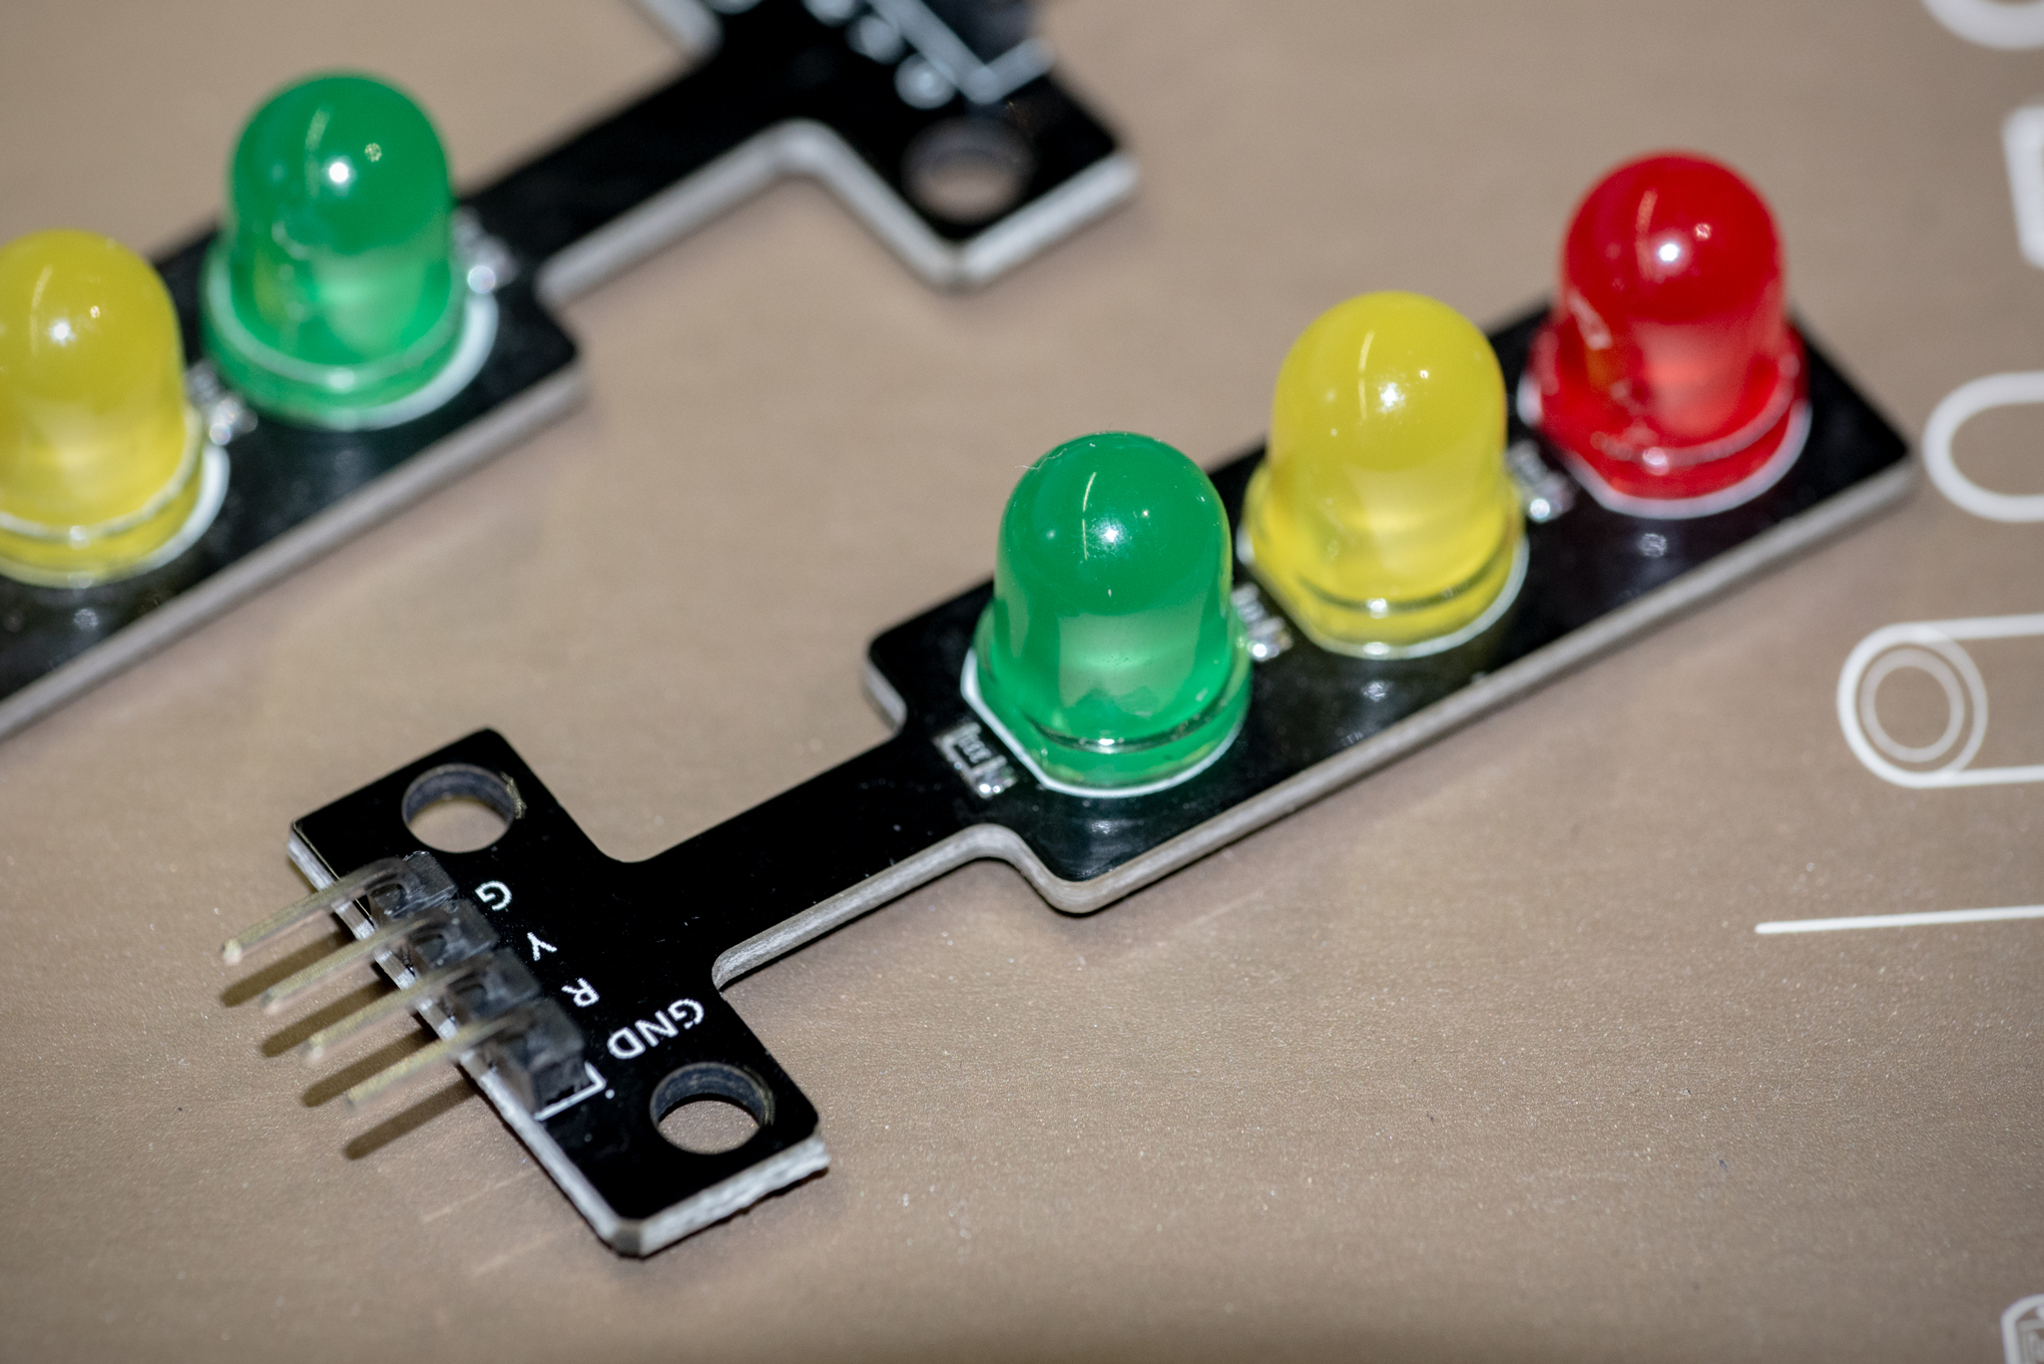
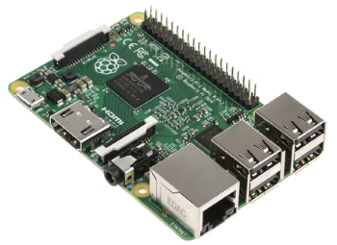
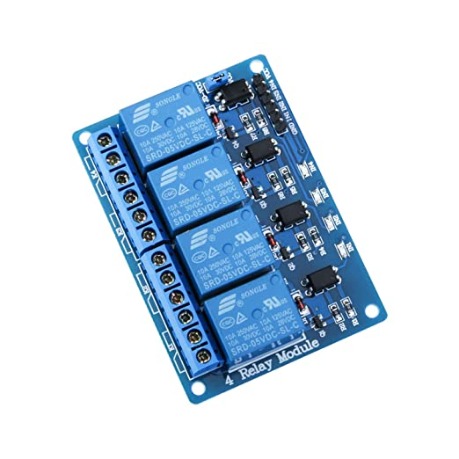

ASTLI
Arduino
Prototype
Commercial version
Raspberry
Relay

Slide 7

ASTLI
ESP32
Data analysis: AWS
Stats page

